Slide 1

Panimalar Engineering College
CSE Department SDG GOALS:
7 – Affordable and Clean Energy
11 – Sustainable Cities and Communities
12 – Responsible Consumption and Production
Batch C8
Team Members: Guide:
211420104203 – Prithiviraj P DR. M. Krishnamoorthy M.E., MBA., Ph.D.,
211420104238 – Sakthivel A
211420104323 – Dhinakaran R

Slide 2
Project Title:
WIND SPEED PREDICTION USING ML
Base Paper Details :
IEEE Transaction Paper : An Instability-Resilient Renewable Energy Allocation System
Domain : Machine Learning
Author : Haoyu Wang, Jeichao Gao
Published : Jan 2023

Slide 3
Abstract:
This study explores the application of machine learning techniques in predicting renewable energy generation. Leveraging historical energy production data and relevant weather parameters, such as solar irradiance and wind speed, a predictive model is developed. Various machine learning algorithms, including regression and time series analysis, are employed to capture complex relationships between weather conditions and energy output. The proposed model demonstrates the ability to forecast renewable energy generation accurately and efficiently. Through extensive experimentation and validation, the study showcases the potential of machine learning in optimizing energy resource management, aiding in grid stability, and facilitating the integration of renewable sources into the power system.

Slide 4
Existing System:
The article proposes a solution to address the challenge of using renewable energy for data centers, which can be environmentally friendly but suffer from energy instability. The instability might lead to interruptions and failures in job execution. Existing efforts to predict energy generation have limitations due to energy instability. The proposed system introduces a renewable energy allocation approach for cloud data centers. The goal is to prevent Service Level Objective (SLO) violations caused by insufficient renewable energy supply while minimizing energy costs and carbon emissions. The system employs deep learning to predict renewable energy tail distributions for future time slots, forecasts energy demand, and predicts CPU utilization for Physical Machines (PMs). Using these predictions, the system allocates renewable energy sources to PM areas, utilizing a Reinforcement Learning (RL)-based method. The proposed system aims to enhance the utilization of renewable energy in datacenters while ensuring consistent operation and sustainability.

Slide 5
Disadvantages:
They analyze the renewable supply demand.
They using less effective machine learning approach.
They did not implemented deploy.
Limited scalability.

Slide 6
Proposed System:
The proposed system focuses on predicting renewable energy generation using machine learning techniques. It collects historical data on variables such as weather conditions, solar radiation, wind speed, and energy production. By employing regression algorithms like linear regression or advanced methods like neural networks, the system creates models to forecast renewable energy output. These models are trained on past data and continuously refined with new information to improve accuracy. Real-time data integration allows the system to provide up-to-date predictions, aiding energy grid management. Regular maintenance ensures the models remain effective in capturing changing patterns and trends. Ultimately, this system facilitates optimized energy distribution and utilization by enabling proactive decision-making based on reliable renewable energy predictions.

Slide 7
Advantages:
We use an advance regression method for this problem.
We build a user-friendly web application.
We analyze the renewable power generation & radiation.
High scalability.

Slide 8
LITERATURE REVIEW:
TITLE: Wind Power Forecasting
AUTHOR: Q. Chen, K. A. Folly
YEAR: 2018
Accurate short-term wind power forecast is very important for reliable and efficient operation of power systems with high wind power penetration. There are many conventional and artificial intelligence methods that have been developed to achieve accurate wind power forecasting. Time-series based algorithms are known to be simple, robust, and have been used in the past for forecasting with some level of success. Recently some researchers have advocated for artificial-intelligence based methods such as Artificial Neural Networks (ANNs), Fuzzy Logic, etc., for forecasting because of their flexibility. This paper presents a comparison of conventional and two artificial intelligence methods for wind power forecasting. The conventional method discussed in this paper is the Autoregressive Moving Average (ARMA) which is one of the most robust and simple time-series methods. The artificial intelligence methods are Artificial Neural Networks (ANNs) and Adaptive Neuro-fuzzy Inference Systems (ANFIS). Simulation results for very-short-term and short-term forecasting show that ANNs and ANFIS are suitable for the very-short-term (10 minutes ahead) wind speed and power forecasting, and the ARMA is suitable for the short-term (1 hour ahead) wind speed and power forecasting.

Slide 9
LITERATURE REVIEW:
TITLE: Wind Power Forecasting with Deep Learning Networks: Time-Series Forecasting
AUTHOR: Wen-Hui Lin, Ping Wang, Kuo-Ming Chao, Hsiao-Chung Lin, Zong-Yu Yang and Yu-Huang Lai
YEAR: 2021
Studies have demonstrated that changes in the climate affect wind power forecasting under different weather conditions. Theoretically, accurate prediction of both wind power output and weather changes using statistics-based prediction models is difficult. In practice, traditional machine learning models can perform long-term wind power forecasting with a mean absolute percentage error (MAPE) of 10% to 17%, which does not meet the engineering requirements for our renewable energy project. Deep learning networks (DLNs) have been employed to obtain the correlations between meteorological features and power generation using a multilayer neural convolutional architecture with gradient descent algorithms to minimize estimation errors. This has wide applicability to the field of wind power forecasting. Therefore, this study aimed at the long-term (24–72-h ahead) prediction of wind power with an MAPE of less than 10% by using the Temporal Convolutional Network (TCN) algorithm of DLNs. In our experiment, we performed TCN model pretraining using historical weather data and the power generation outputs of a wind turbine from a Scada wind power plant in Turkey. The experimental results indicated an MAPE of 5.13% for 72-h wind power prediction, which is adequate within the constraints of our project. Finally, we compared the performance of four DLN-based prediction models for power forecasting, namely, the TCN, long short-term memory (LSTM), recurrent neural network (RNN), and gated recurrence unit (GRU) models. We validated that the TCN outperforms the other three models for wind power prediction in terms of data input volume, stability of error reduction, and forecast accuracy.

Slide 10
AIM AND OBJECTIVE:
Aim:
Every grid operator has the same issue with their successful integration to meet current demand due to the intermittent nature and limited control over the wind conditions. The grid operator now also has to forecast the availability of wind and solar generation facilities in the upcoming hour, day, or week in addition to needing to forecast demand and balance it with supply. So, this project can easily find out the Wind Power Generation.
Objectives:
The goal is to develop a machine learning model for wind power generation prediction, to potentially replace the updatable supervised machine Learning Classification models by predicting results in the form of best accuracy by comparing supervised algorithms.

Slide 11
LIST OF MODULES:
Data Pre-processing
Data Analysis of Visualization
Implementing Algorithm 1
Implementing Algorithm 2
Implementing Algorithm 3
Deployment

Slide 12
Environmental Requirements:
Environmental Requirements:
1. Software Requirements:
Operating System : Windows 10 or later
Tool : Anaconda with Jupyter Notebook
2. Hardware requirements:
Processor : Intel i3 or later
Hard disk : minimum 10 GB
RAM : minimum 4 GB

Slide 13
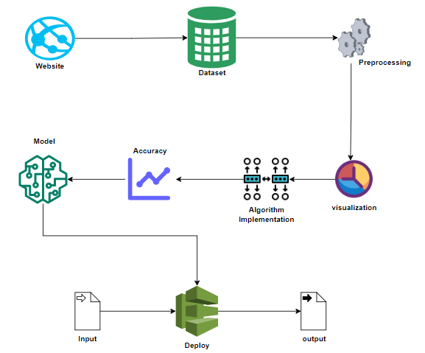
System Architecture:
.

Slide 14
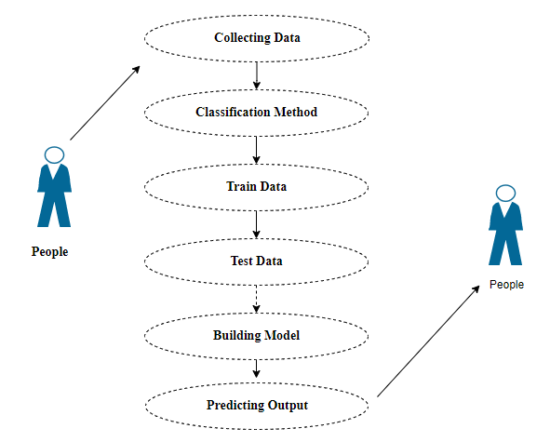
Use Case Diagram:

Slide 15
MODULE DESCRIPTION:
Data Pre-processing:
Validation techniques in machine learning are used to get the error rate of the Machine Learning (ML) model, which can be considered as close to the true error rate of the dataset. If the data volume is large enough to be representative of the population, you may not need the validation techniques. However, in real-world scenarios, to work with samples of data that may not be a true representative of the population of given dataset. To finding the missing value, duplicate value and description of data type whether it is float variable or integer. The sample of data used to provide an unbiased evaluation of a model fit on the training dataset while tuning model hyper parameters.

Slide 16
Data visualization:
Data visualization is an important skill in applied statistics and machine learning. Statistics does indeed focus on quantitative descriptions and estimations of data. Data visualization provides an important suite of tools for gaining a qualitative understanding. This can be helpful when exploring and getting to know a dataset and can help with identifying patterns, corrupt data, outliers, and much more. With a little domain knowledge, data visualizations can be used to express and demonstrate key relationships in plots and charts that are more visceral and stakeholders than measures of association or significance. Data visualization and exploratory data analysis are whole fields themselves and it will recommend a deeper dive into some the books mentioned at the end.

Slide 17
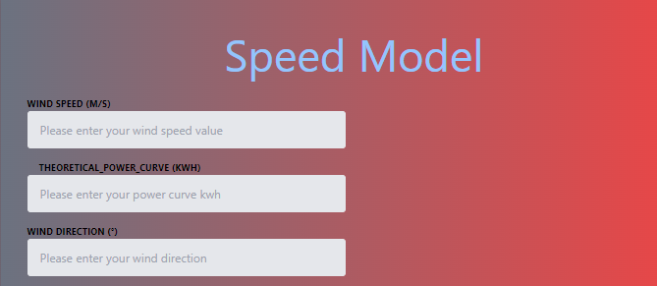
OUTPUT SCREENSHOT:

Slide 18
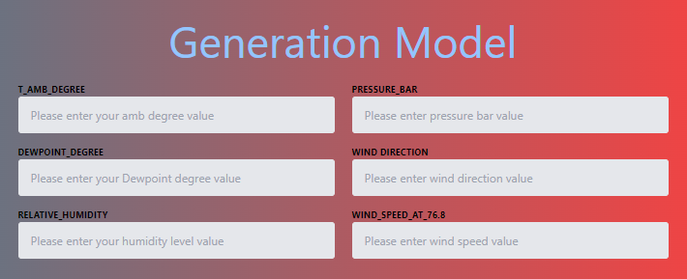

Slide 19
References
R. Karp and M. Rabin “Efficient randomized pattern-matching algorithms”, IBM J .Res. Develop., Vol. 31, pp.249-260, 1987
D. Specht, “A general regression neural network”, IEEE Trans. Neural Netw., vol 2, no. 6,pp.568-576, NOV. 1991.
H. Sorensen, “Real-valued fast fourier transform algorithms”, IEEE Trans. Acoust . Speech. Signal Process., vol. 35, no.6, pp. 849-863,Jun.1987
M. Kweun, W.Lee, G. Kim, J.Hawng, and Y. Lee, “Lineage checkpoint approach for lomg-lineage problem in apache spark”, in Proc. IEEE Int.Conf. Big Data, 2020, pp.5733-5735

Slide 20
Conclusion:
The energy balance of wind energy is exceptionally certain. The energy consumed in the entire chain of wind plants is recuperated in a few normal functional months. The correlation of wind energy with ordinary innovations features the ecological benefits of wind energy. The analytical process started from data cleaning and processing, missing value, exploratory analysis and finally model building and evaluation. The Best accuracy on public test set is higher accuracy score is will be find out. This application can help out to find the Wind Power Prediction.

Slide 21
Future Work:
Wind Power Generation Prediction to connect the AI Model.
To Optimize the Work to implement in AI Environment.

